Slide 1
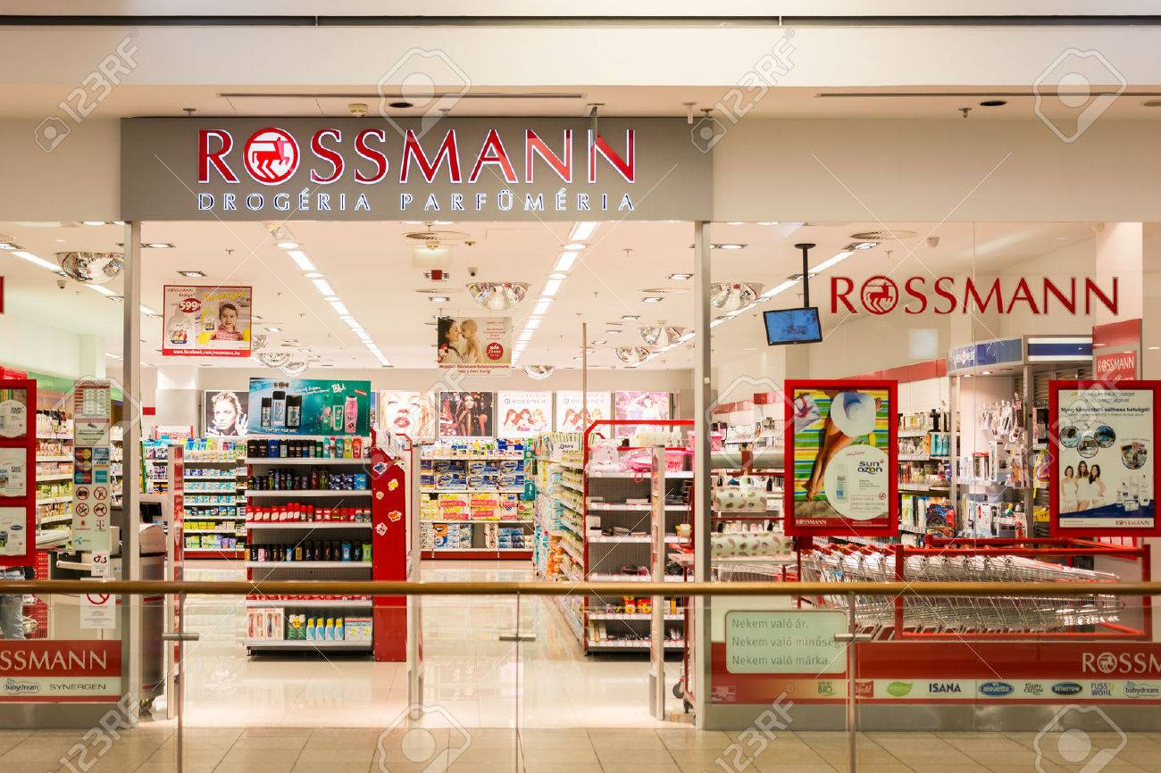
PROJECT - END TO END SALES PREDICTION SOLUTION FOR RETAIL STORES NAME - YAMINI NAGPURE

Slide 2
CASE STUDY:
Objective of the case .
Customer Purchasing Behaviour Analysis.
Sales Prediction Based on Machine Learning with Scikit- Learn Pipelines.
Sales Prediction.
Model Serialization.
Conclusion.

Slide 3
Objective:
Analyze Customer Purchasing Behaviour.
2. Use Machine Learning Approach for Forecasting.
3. Predict daily sales for Six weeks.

Slide 4
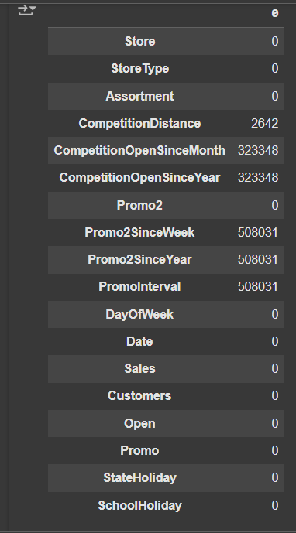
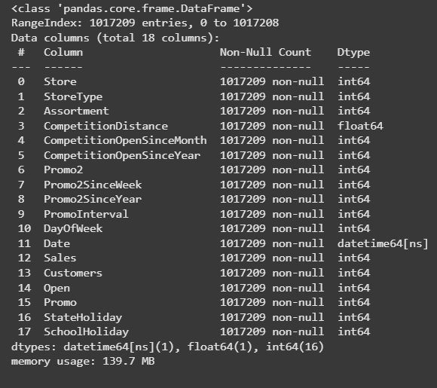
EDA - Exploratory Data Analysis
Null Values in Data Set
Label Encoder
CompetitionDistance has 2,642 missing values.CompetitionOpenSinceMonth and CompetitionOpenSinceYear have 323,348 missing values.Columns like Promo2SinceWeek, Promo2SinceYear, and PromoInterval have over 508,031 missing values.Columns such as Store, Sales, Customers, and Promo have no missing data.
Label Encoder has been applied and Data Types were converted to Integer and Float Types
Columns like Store, StoreType, and Assortment are integer-encoded.The dataset has 18 columns with various data types (e.g., float64, int64, datetime64).

Slide 5
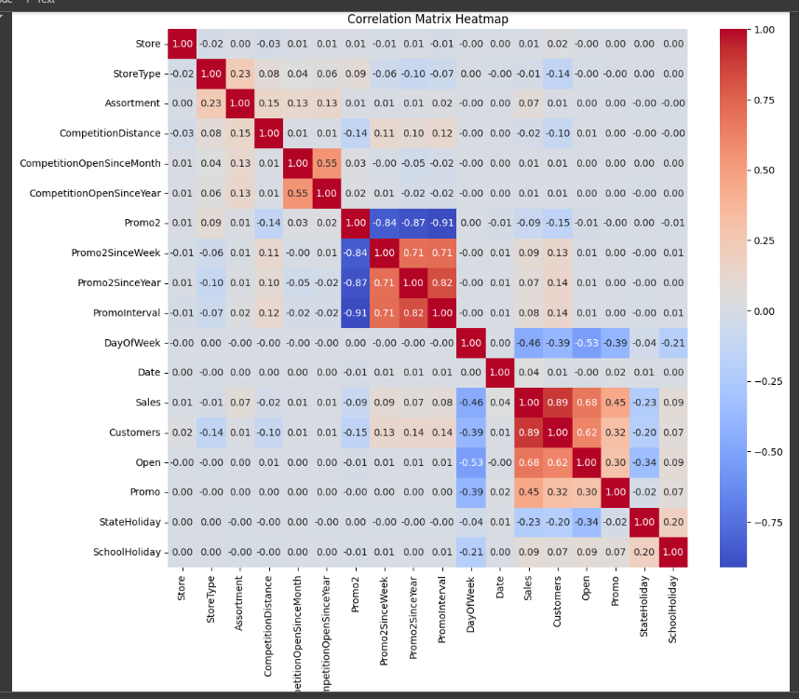
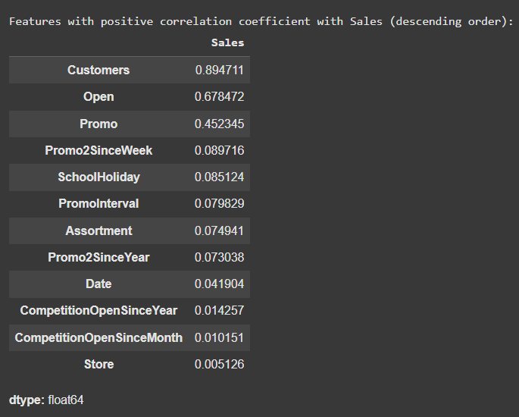
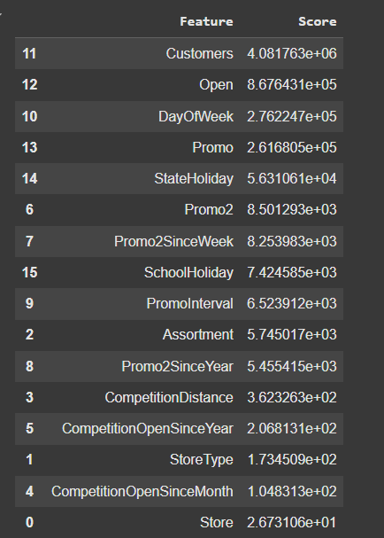
Feature Extraction and Correlation
Features "Customer" and "Open" have high positive correlation with Sales.Features "PromoStore " and "Competition Open" have least correlation with Sales.

Slide 6
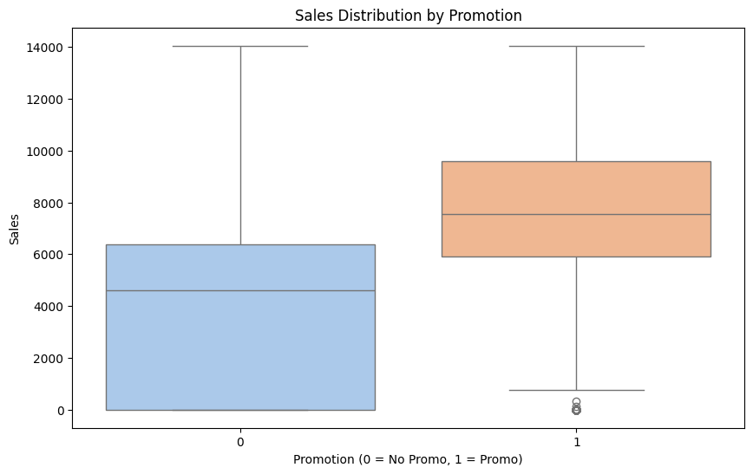
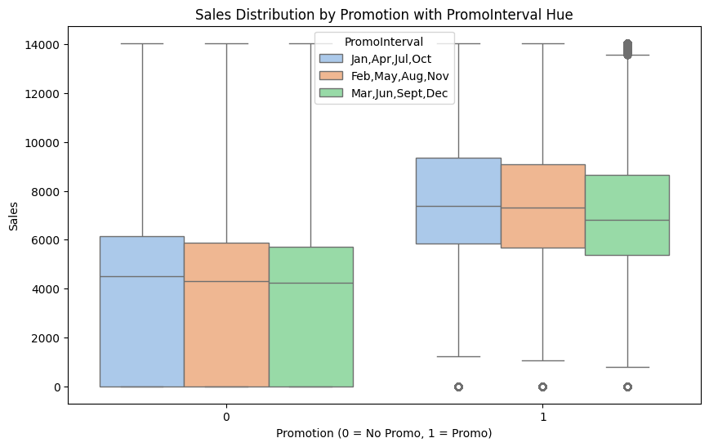
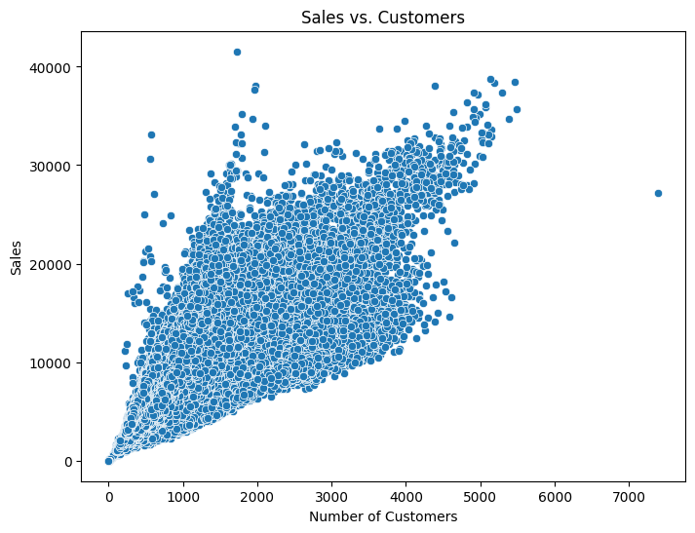
Outlier Treatment And Sales Insight
Sales is significantly impacted by Promotion
There is Average sales of 7836 unit with promotion and without promotion the average sales is 4367 unit
Number of customer visits are having a significant impact on sales, the more it is the more is the sales

Slide 7
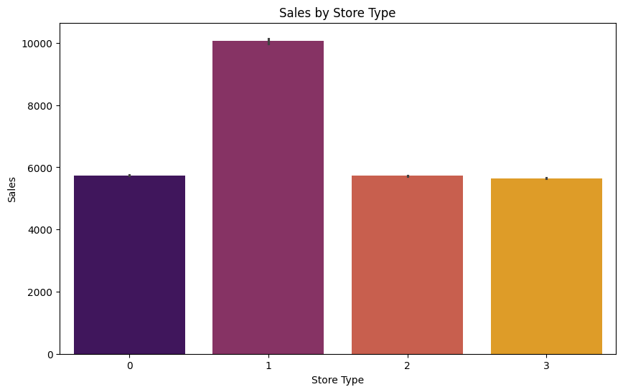
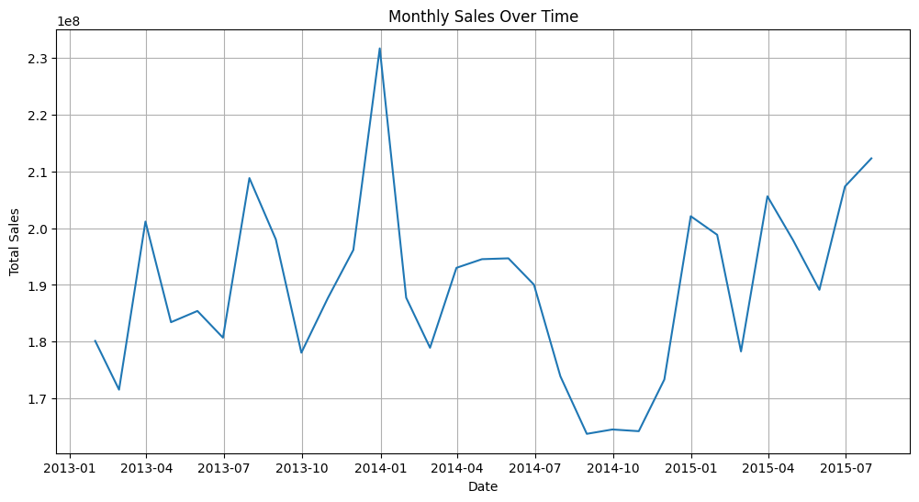
Sales and storetype bar plot
Monthly Sales Over Time
High volatility in data,significant spike in middle of the time period.The trend seems to end on a slight upward trajectory.
The data suggest cyclical or seasonal patterns in the line graph.
Store type 1 has maximum sales.

Slide 8
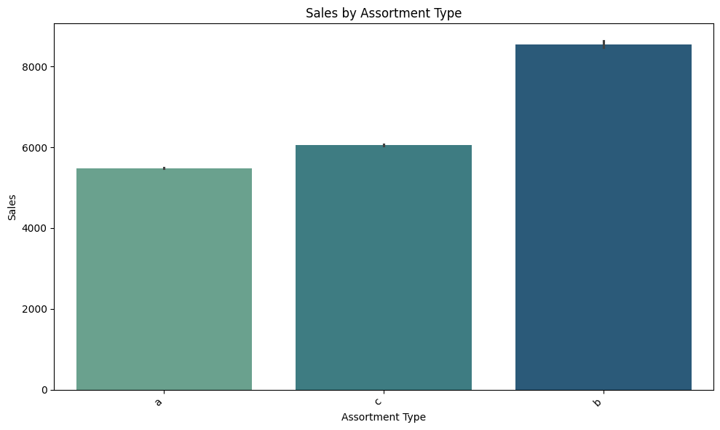
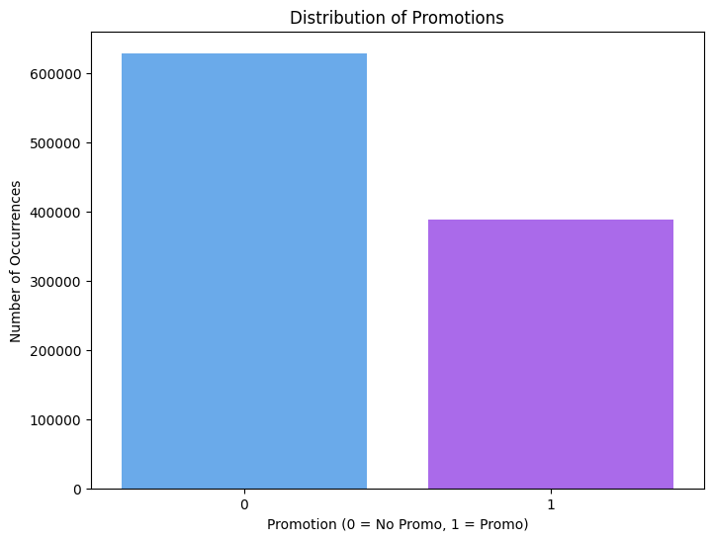
User Overview Analysis
Store Type “B” has got the maximum sales

Slide 9
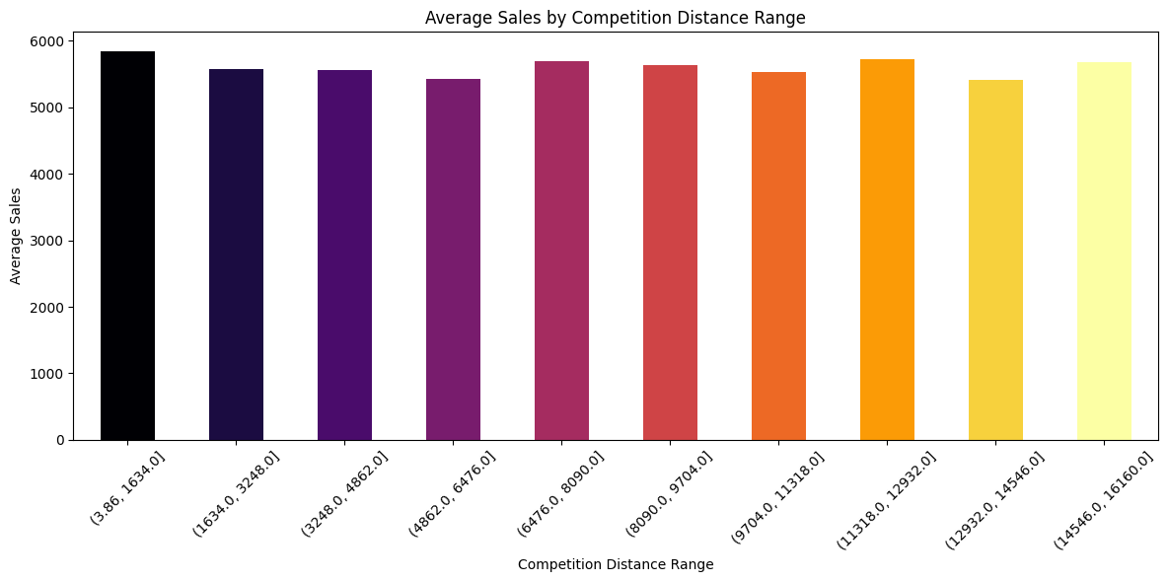
Shortest the distance higher is the sales Highest sales lies in a distance binned between 3.86 to 1634 Lowest Sales of 5417.89 lies at a distance binned between 12932 and 14546

Slide 10
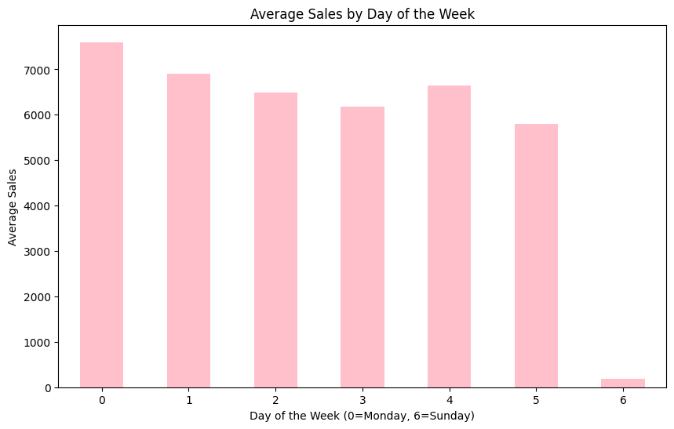
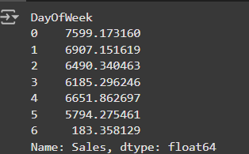
Average sale of Monday is higher than the other days i.e 7599.173160 Sunday has the least average sale day i.e
183.358129

Slide 11
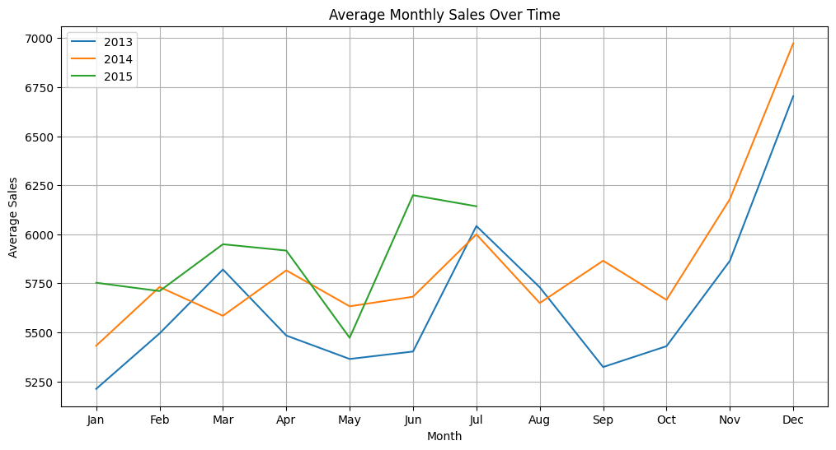
Investigate Seasonal Purchasing Patterns (e.g., Christmas, Easter).
total duration spent and total data volume consumption for top 6 MSISDN/Number
December time , holiday or Christmas Time sales are at all time high for the Years 2013 and 2014, compared to other months of the Year

Slide 12
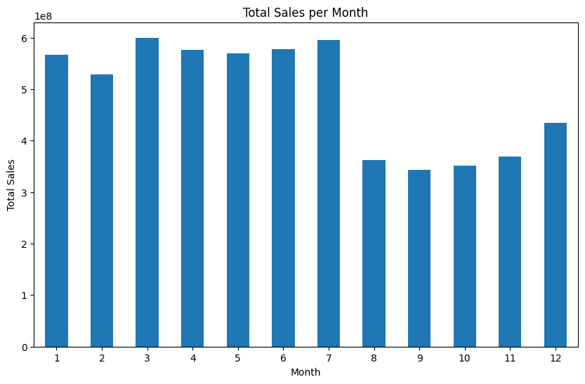
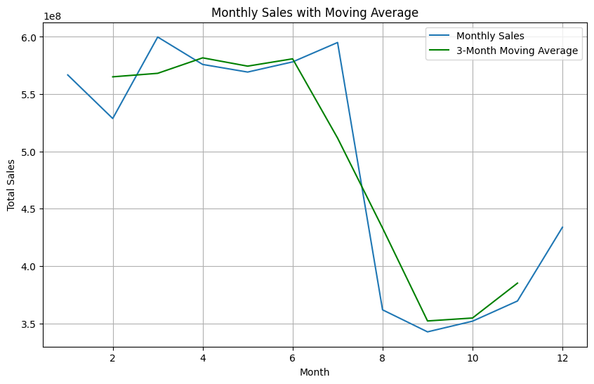
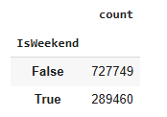

Average Monthly Sales During Holiday and Non Holiday Months
Weekend(DayofWeek>5) and Weekday(DayofWeek<5) have been created
72% of the data is from Week Day and 28% is from Week End

Slide 13
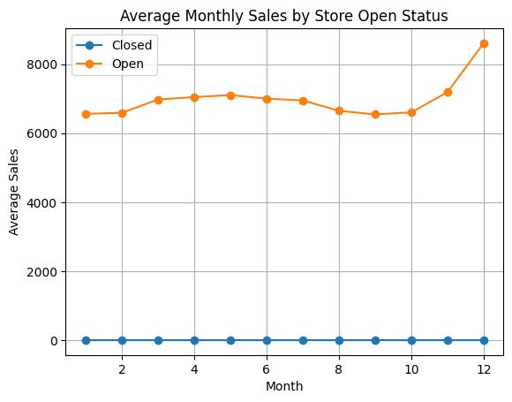
Store Opening has got a significant impact on Sales

Slide 14
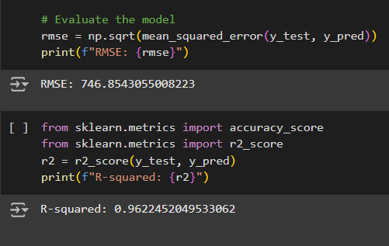
Machine Learning Algorithm- RandomForest Model Predictions
Above features are having maximum influence on Sales
The root Mean square error of the Model was 746.85
The accuracy of the Model was Found to be 0.96

Slide 15
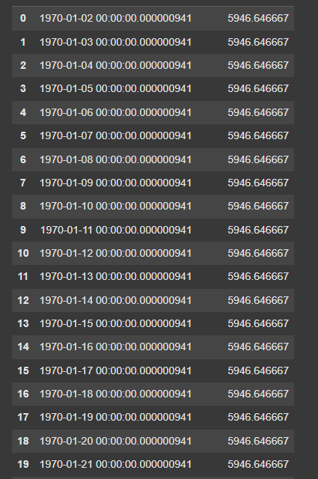
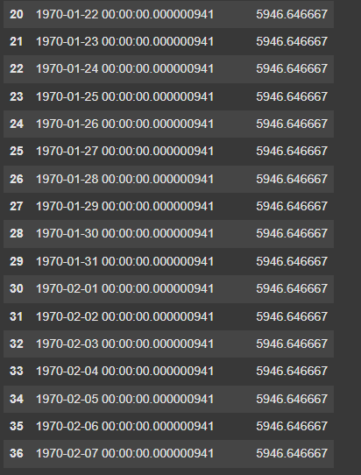
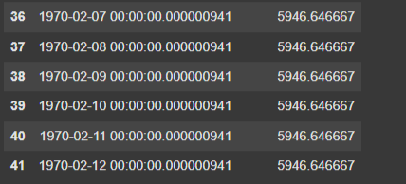
Sales prediction for six week

Slide 16
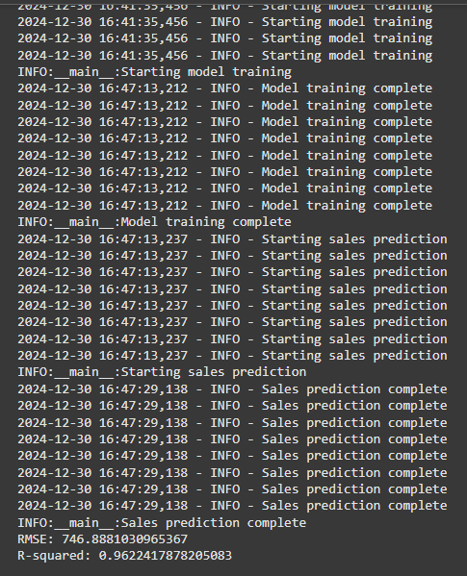
Logger File and Modular Pipe Line Building
Logger File has been used to streamline the process flow from data loading to model building, it has been saved in app.log file
Modular pipe line has been developed to sequentially build the project flow
Below is the ouput of the log and pipeline operation

Slide 17
Conclusion
Random Forest Model performs best
Also Based on Random Forest Model , Sales forecast for first 10 IDS were found
Model Serialization(.pkl) file supports in saving the model and its parameters
From the last date of the data set , for next 42 days sales were predicted and saved in salespredict.csv file
Logger file and Pipeline was build to smoothen the execution flow of the project
Promotion is having significant impact on sales
More the distance the competitor less is the sales

Slide 18
Thank you

